Slide 1

Proton Computed Tomography
The Positive Medical Imaging Technique
Keith Evan Schubert
Professor of Computer Science and Engineering
California State University, San Bernardino

Slide 2
Why Protons?
100
Photon
Proton
Dose %
Electron
Depth in Tissue

Slide 3
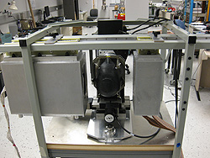
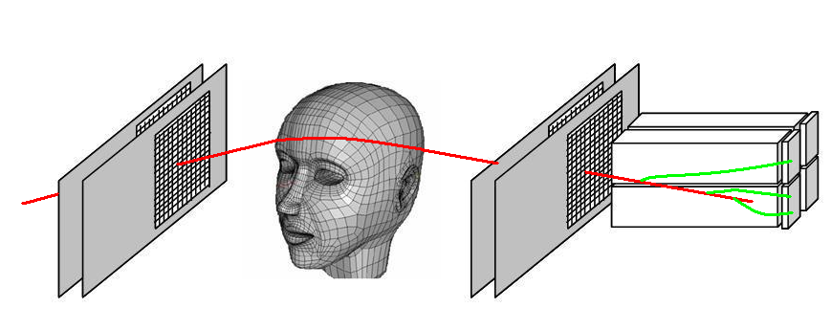
pCT Scanner

Slide 4
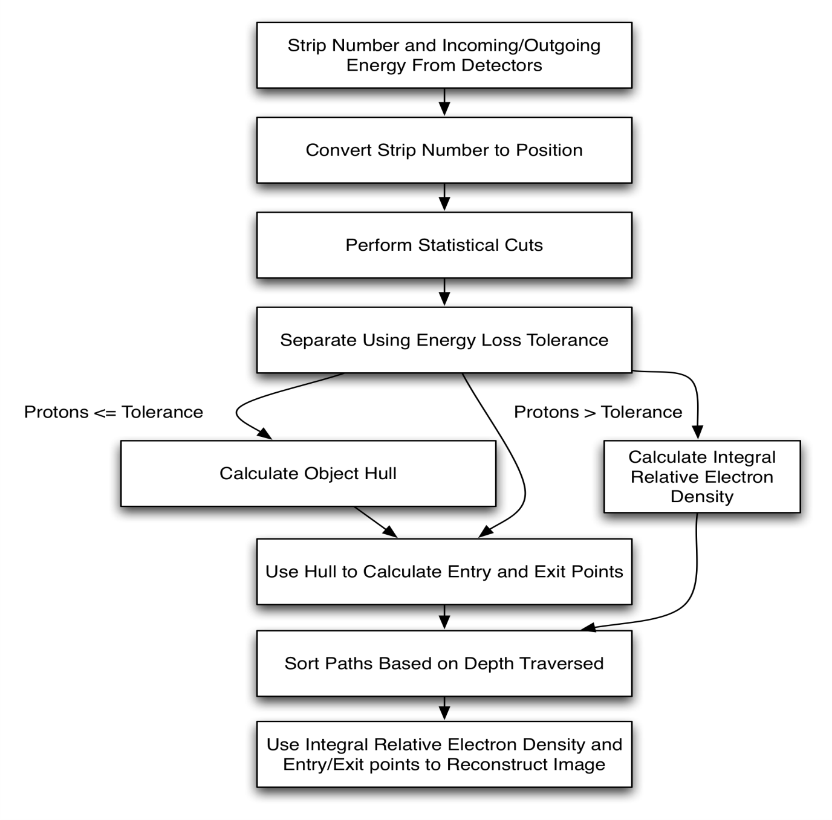
Problem
Flow

Slide 5
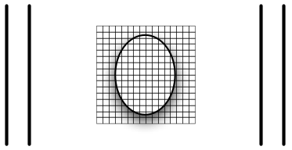
Discretized Area
Notes:
Using the discretized area described earlier and here by the dashed-dotted square between the detectors
With 21.21cm x 21.21cm and a voxel size of 0.25mm x 0.25mm gives

Slide 6
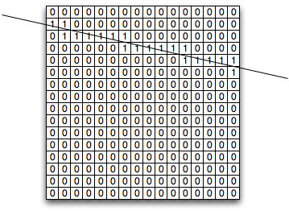
A Proton Path

Slide 7
Problem Size
~10⁷ voxels
~ 10⁸ proton paths (min)
~ 400 voxels/paths
Thus:
Size(A)
~ 10⁷10⁸ = 1 PB (dense)
Computation SVD
~ 10⁷10⁷10⁸ =
10¹⁰ Tflops/Cycle

Slide 9
Problem Size
~10⁷ voxels
~ 10⁸ proton paths (min)
~ 400 voxels/paths
Thus:
Size(A)
~ 10⁸  10³ ⁼100 GB
Computation ART
~ 10³10³10⁸ =
10² Tflops/Cycle

Slide 10
Problem
Flow

Slide 11
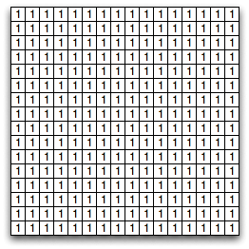
Convex Hull

Slide 12
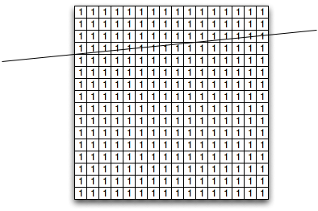
Convex Hull

Slide 13
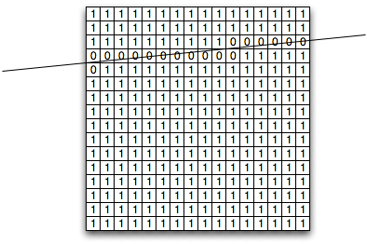
Convex Hull

Slide 14
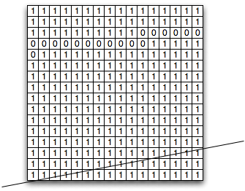
Convex Hull

Slide 15
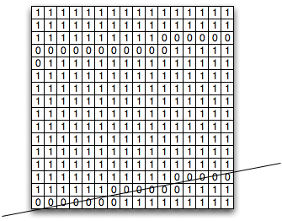
Convex Hull

Slide 16
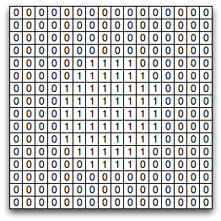
Convex Hull

Slide 17

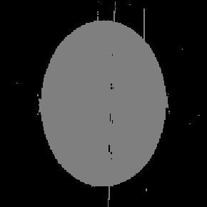
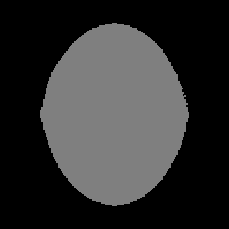
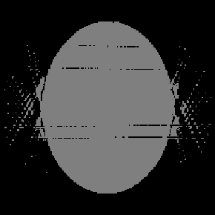
Simulation
Space Carving
Filtered Back Projection
No Noise
Noise

Slide 18
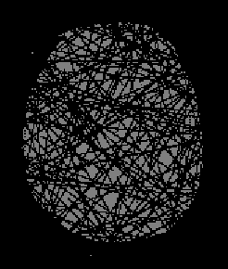
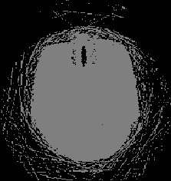
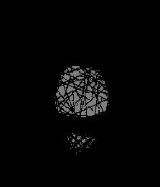
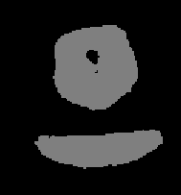
Actual Scans
Space Carving
Filtered Back Projection
Pediatric
Head
Phantom
Rat Head
Notes:
Convex hull approximation provides

Slide 19
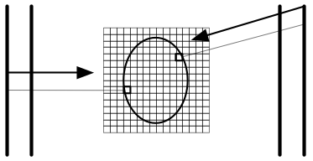
Calculating Entry and Exit Points
Notes:
We have the information for the entry and exit positions provided by the detectors.
Using that information, we calculate the entry and exit angles
We then project forward and backward the respective positions until one of the voxels marked as being in the image is hit
These voxels will be used as the entry and exit points when calculating the most likely path through the object

Slide 20
Problem
Flow

Slide 21
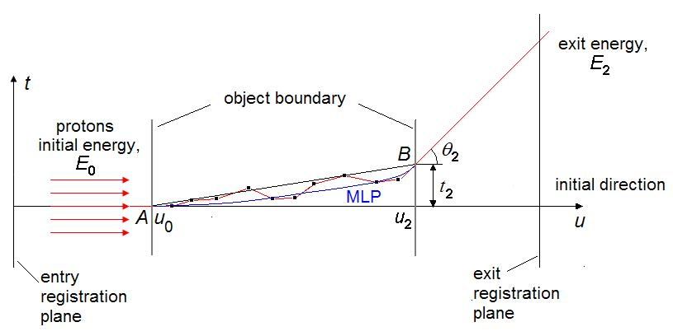
The Most Likely Path (1)

Slide 22
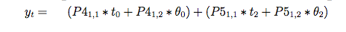
The Most Likely Path (2)
79 flops / step
Redundant calculations (Sigma/R)
  1600 possible (20.0 cm depth x 0.125 mm step)
  10⁸ -10⁹ histories
Precalculate all Sigma/R terms
7 flops/step

Slide 23
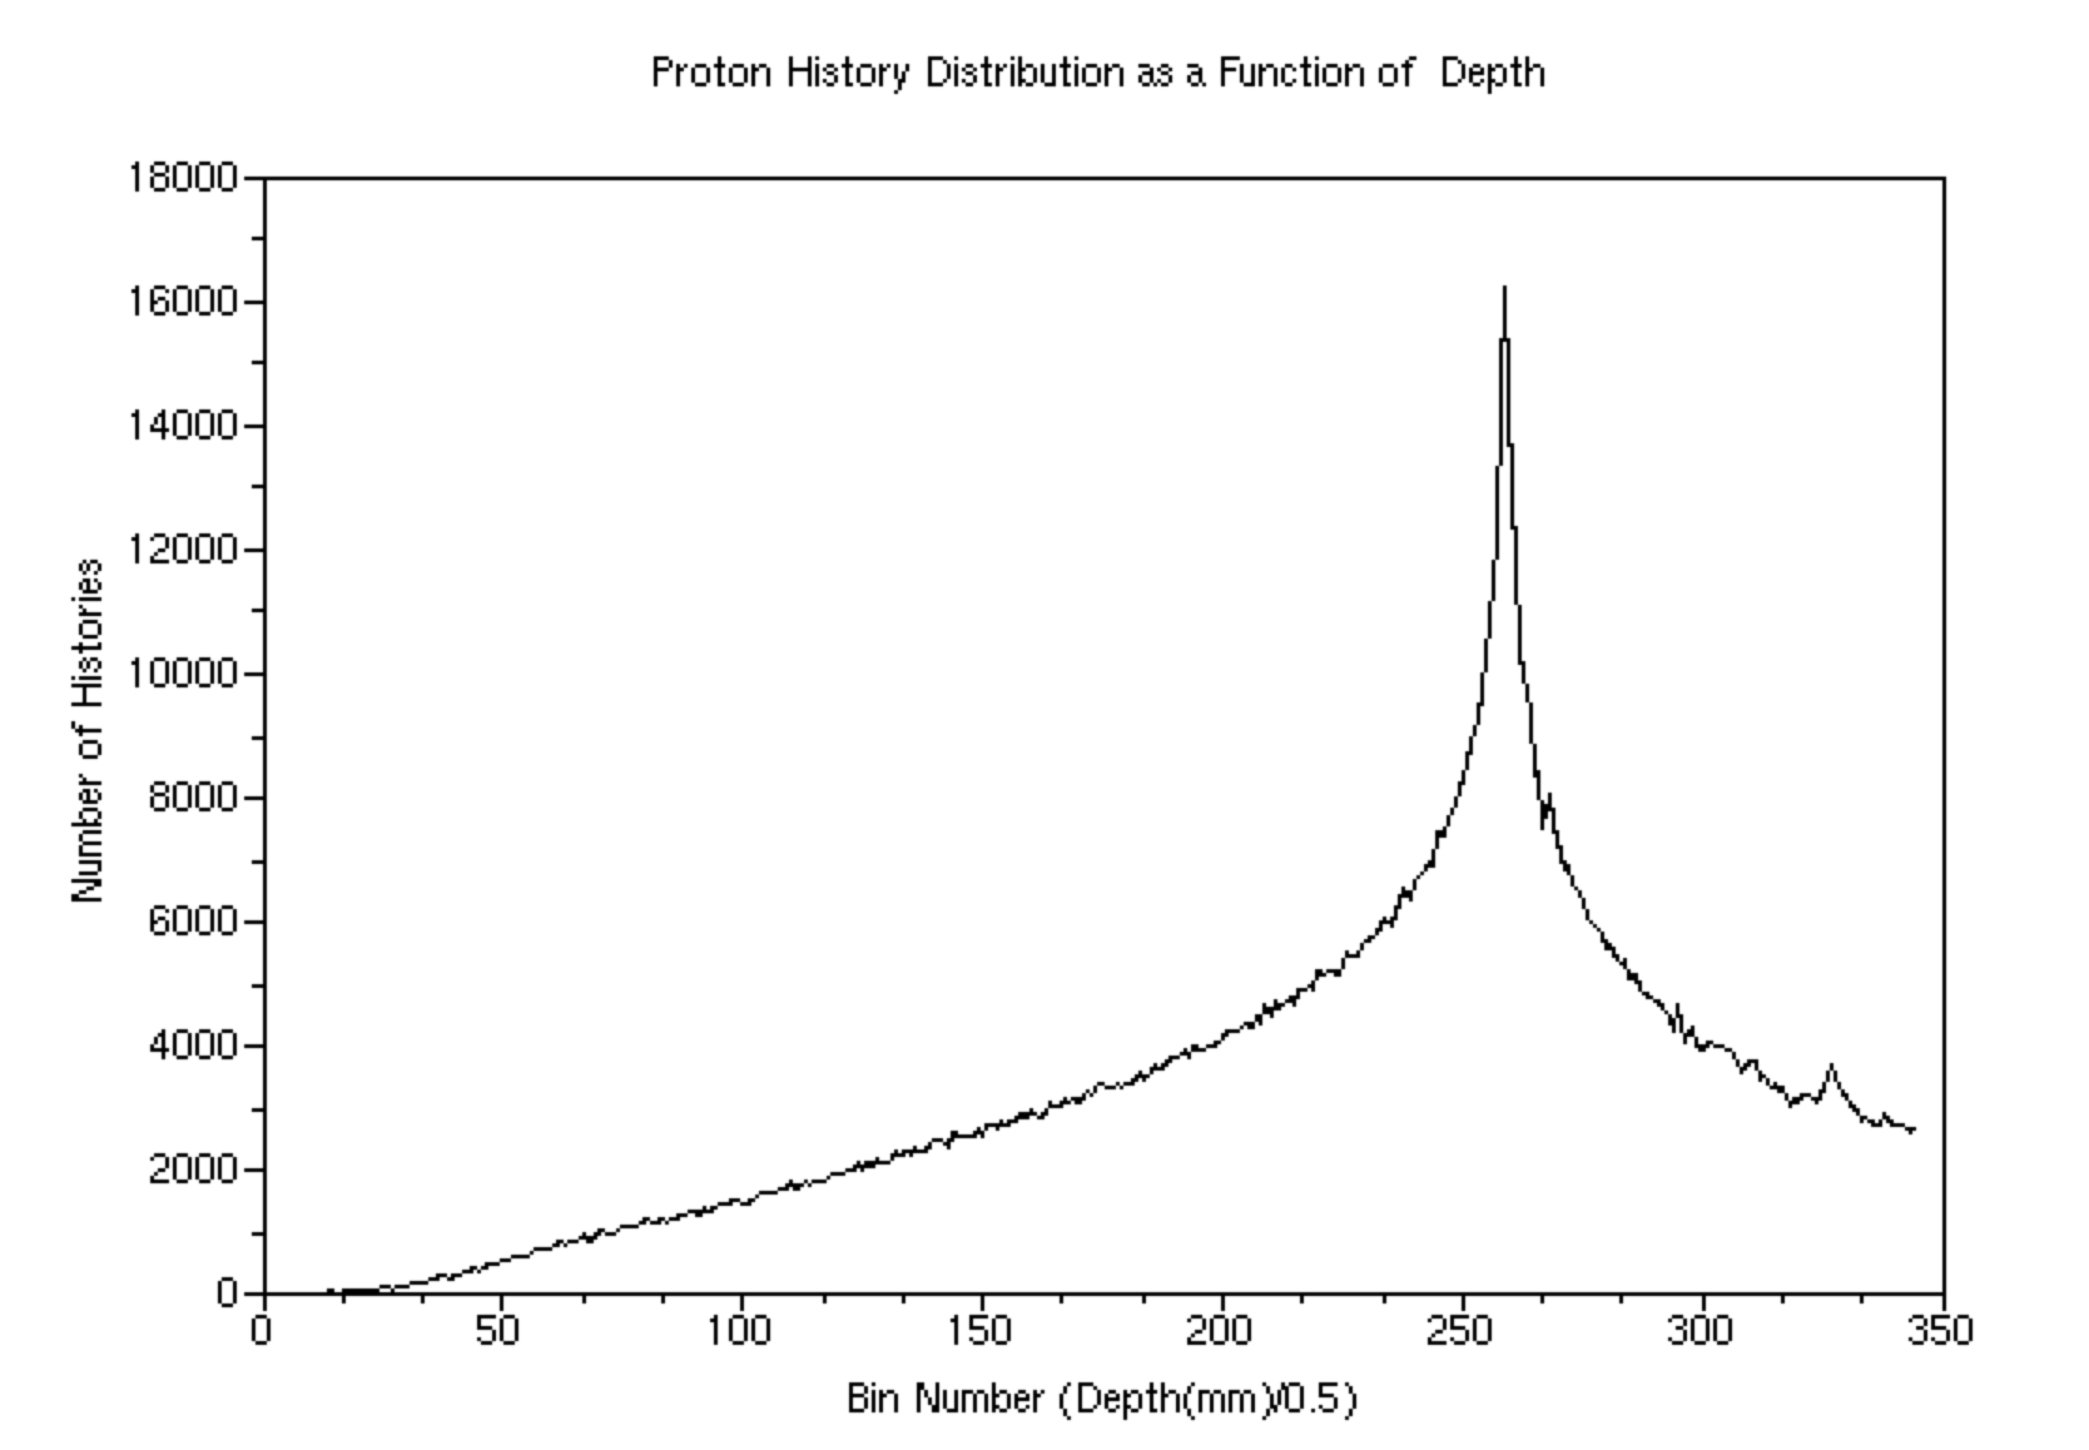
Proton Histories vs. Depth

Slide 24
Reconstruction
Sparse Sequential algorithm
  ART
Sparse Parallel algorithm
  Fully simultaneous algorithms
    Cimmino, CAV
  Block iterative
    BIP, BICAV, DROP, OS-SART
  String averaged
    SAP, CARP

Slide 25
ART
x₀
x₁
x₀
x₆
x₅
x₂
x₄
x₃

Slide 26
Cimmino
x₀
x₀
x₁

Slide 27
Block Iterative Projections
x₀
x₀
x₁

Slide 28
Block Iterative Projections
x₀
x₀
x₁
x₂

Slide 29
String Averaged Projections
x₀
x₀
x₁

Slide 30
BIP
X_{k+1}
x_{k}
ai
Notes:
30

Slide 31
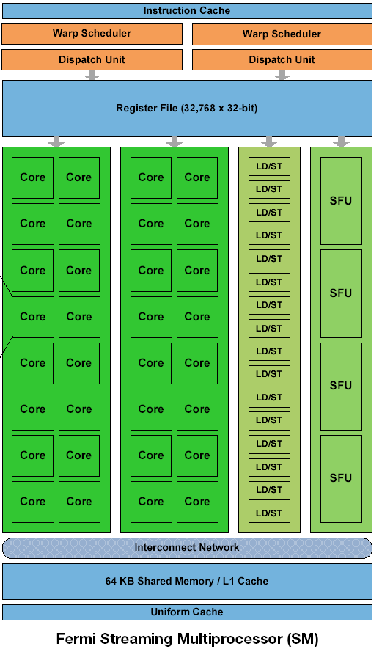
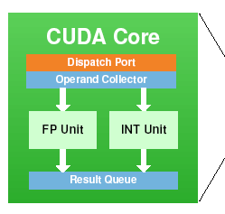
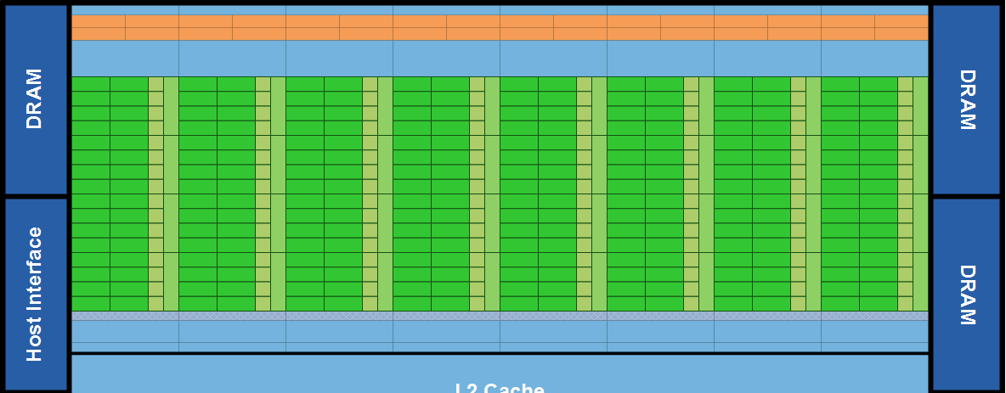
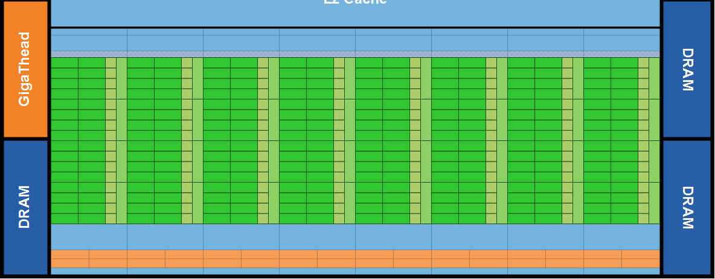
Fermi

Slide 32
Iteration
Calculate Residual
Sync Blocks
Update x
b - A x = R
x += c A^{T} R
-

Slide 33
Summing In Inner Product
0
1
2
3
4
5
6
7
8
9
10
11
12
13
14
15
8
10
12
14
16
18
20
22
24
28
32
36
56
64
120

Slide 34
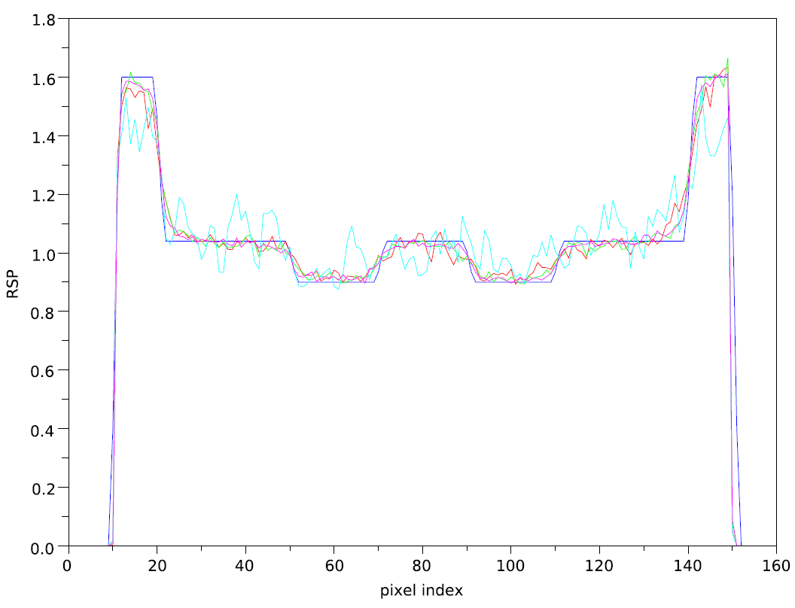
SAP Number of Histories
Protons=voxels
Protons=5 voxels
Protons=10 voxels
Protons=20 voxels

Slide 35
SAP Relaxation Parameter
0.01
0.1
0.2
0.5

Slide 36
Conclusions
A simple convex hull calculation is fast and precise
GPGPU acceleration yields a three order of magnitude increase in speed
Pre-calculating and binning yields a two order of magnitude increase in speed
SAP gives good convergence and image quality
2D (single machine) 12 hours to a few seconds
3D (cluster) day to under 30 minutes
More to do…

